Slide 1
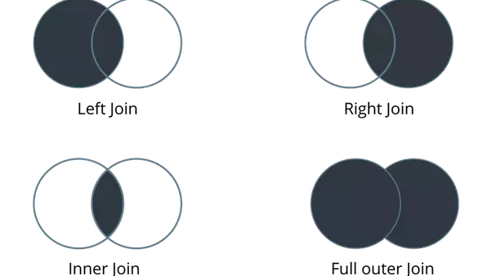
Blending & Joins
Notes:
https://en.wikipedia.org/wiki/Join_(SQL)
Data blending: multiple data sources, which you want to analyze together in a single view.

Slide 2
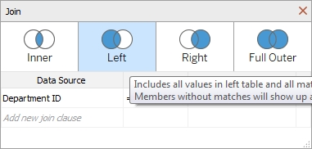

Slide 3
Blending & Joins
Creating Bins
Forecasting
Trend Lines
Reference Lines

Slide 4
https://www.tutorialspoint.com/tableau/tableau_data_blending.htm
https://help.tableau.com/current/pro/desktop/en-us/multiple_connections.htm

Slide 5
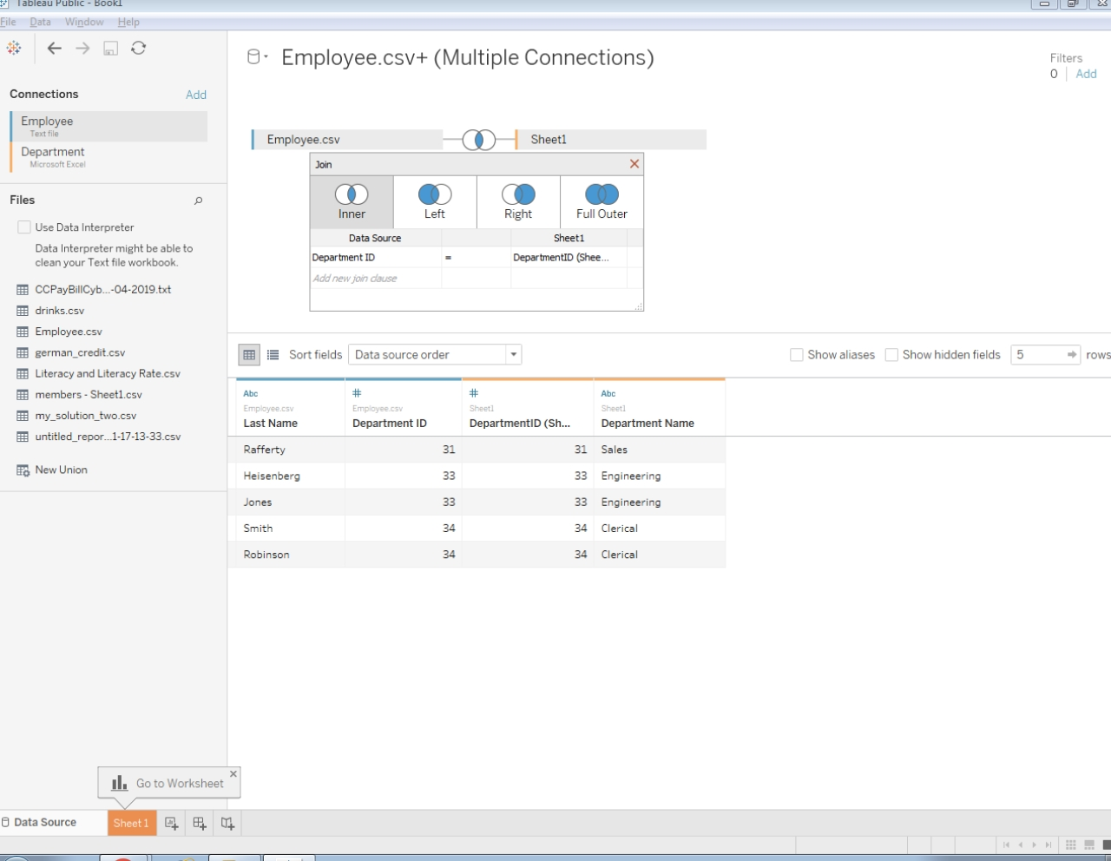

Slide 6
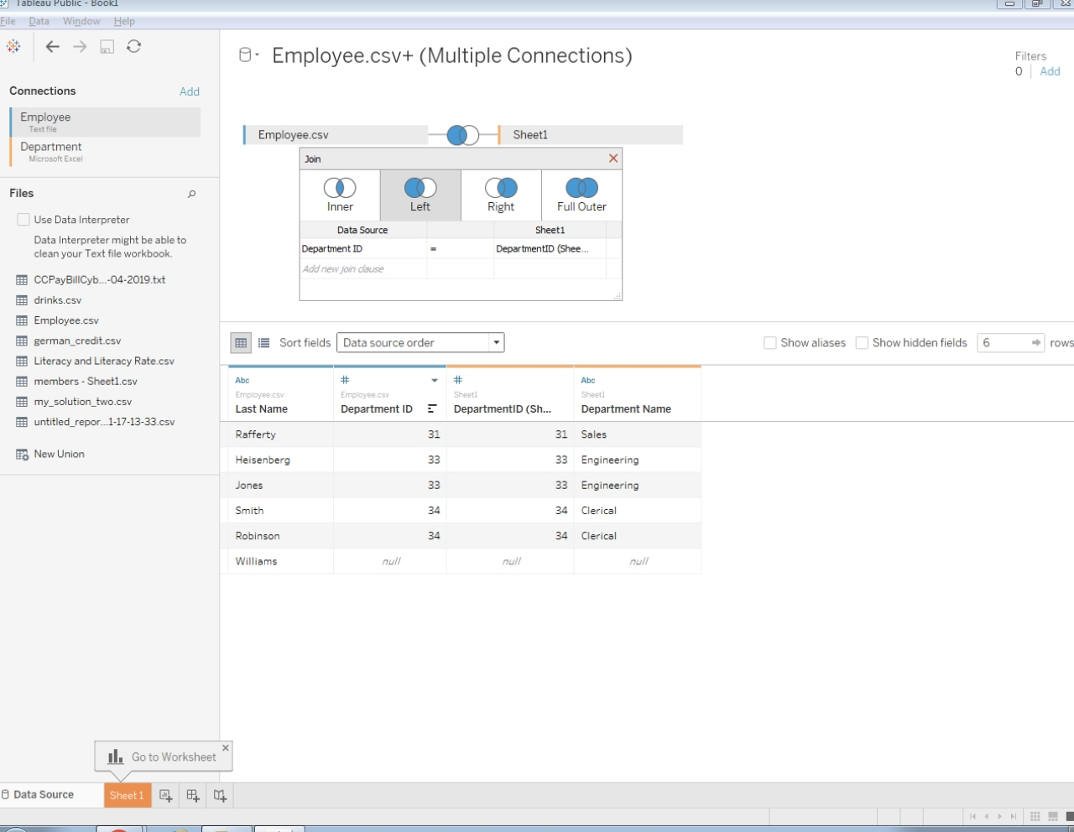

Slide 7
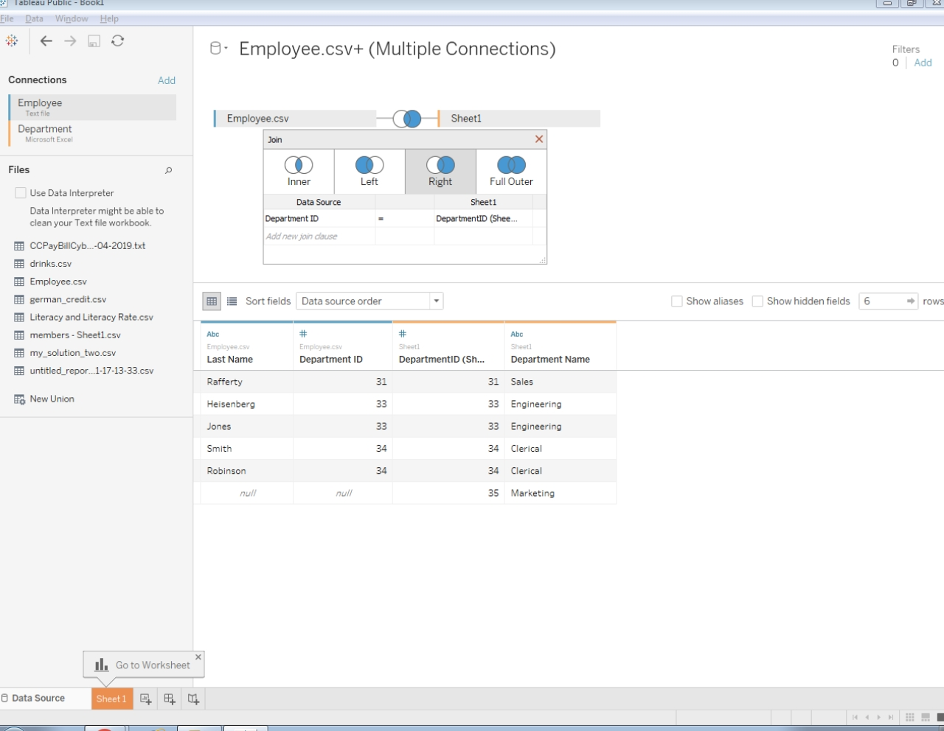

Slide 8
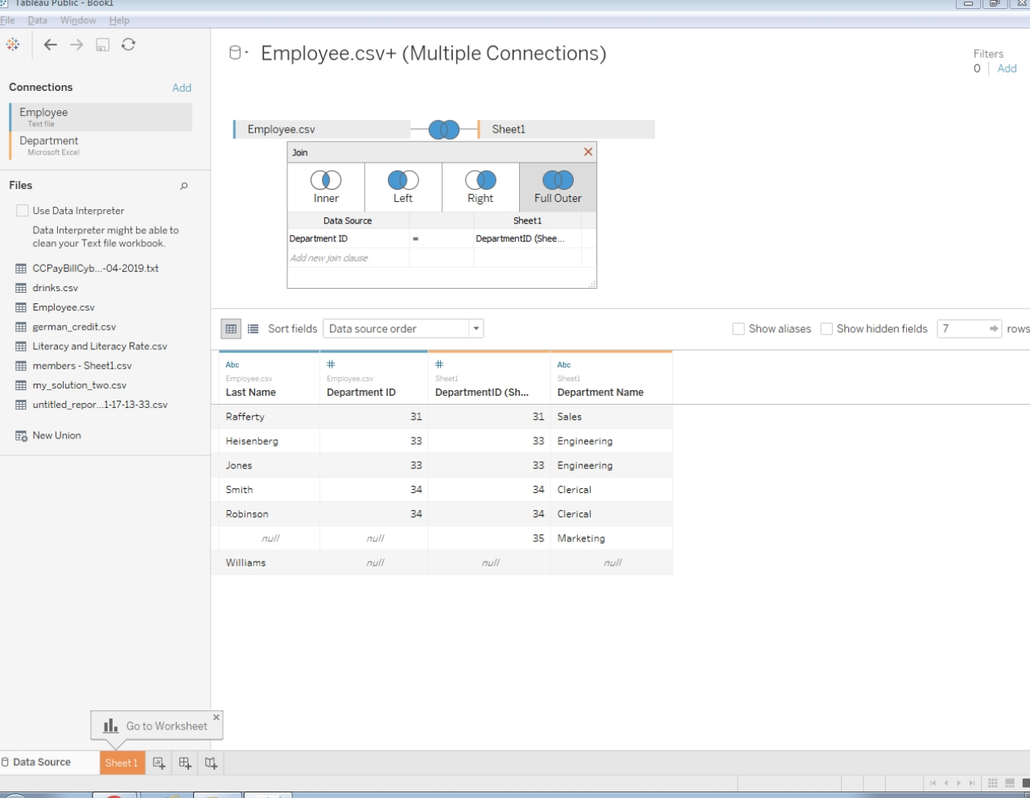

Slide 9
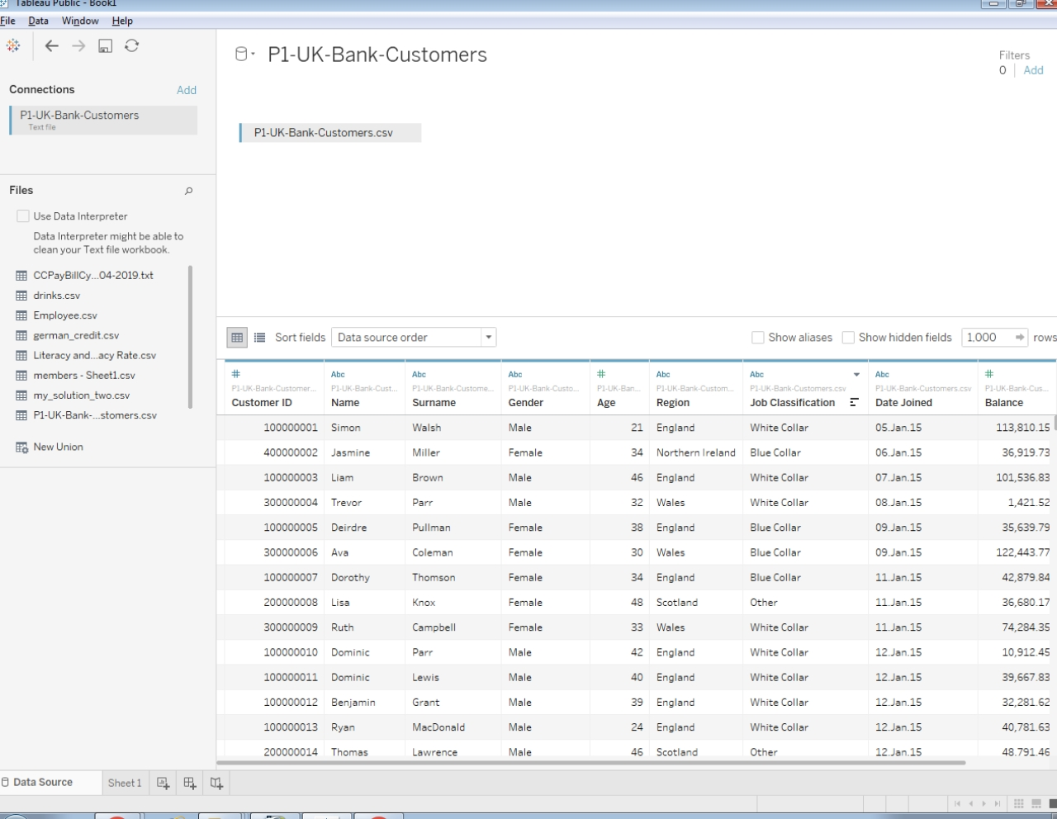
Bins

Slide 10
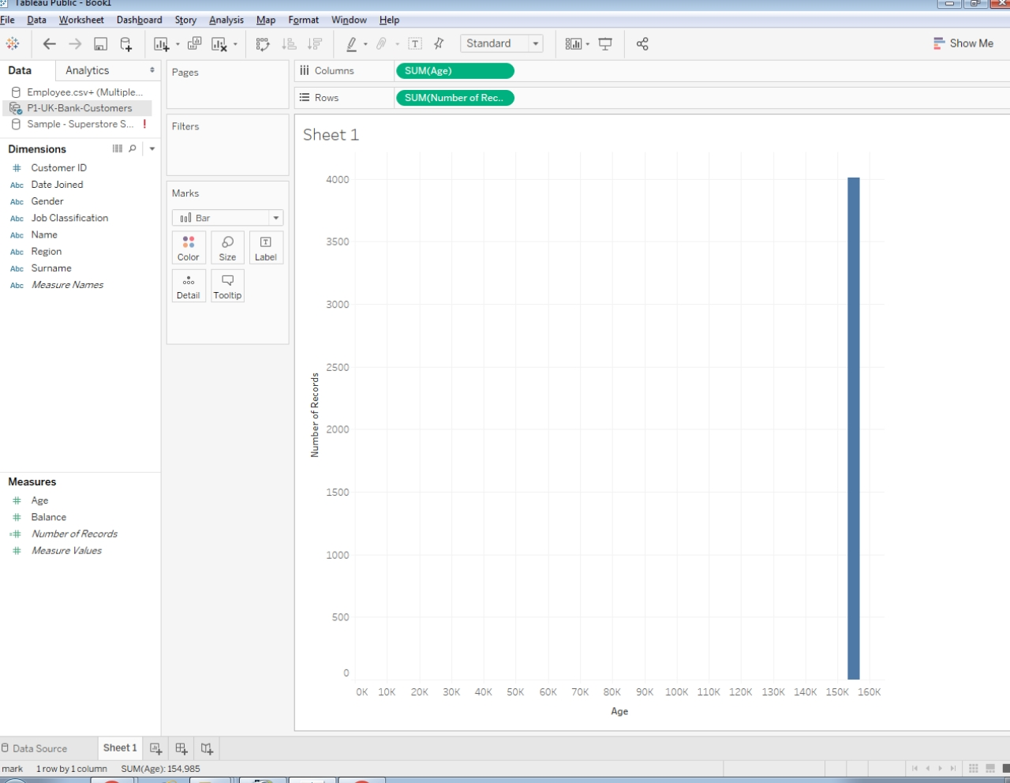

Slide 11
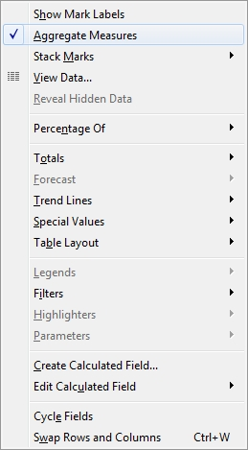
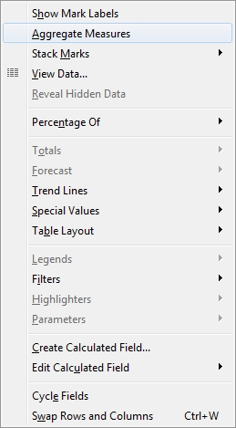

Slide 12
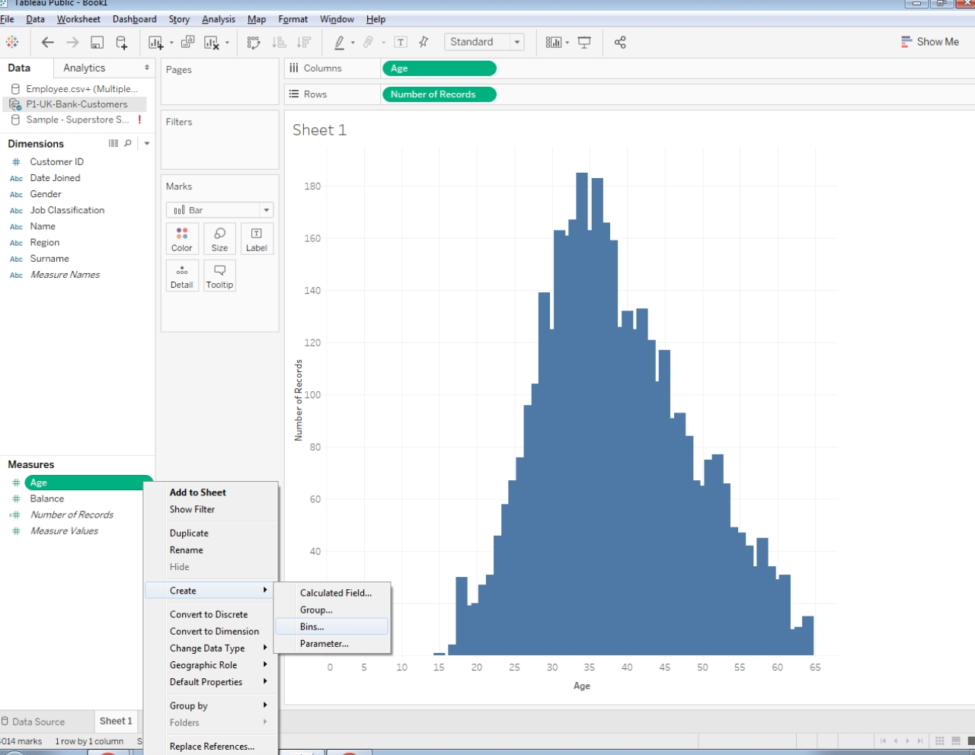

Slide 13
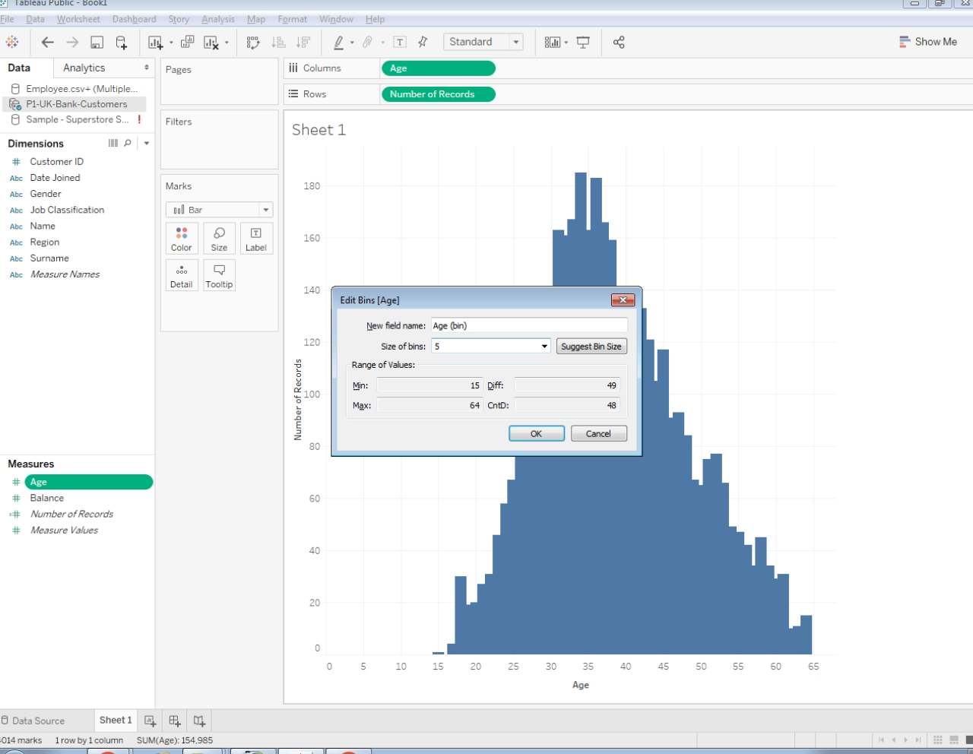

Slide 14
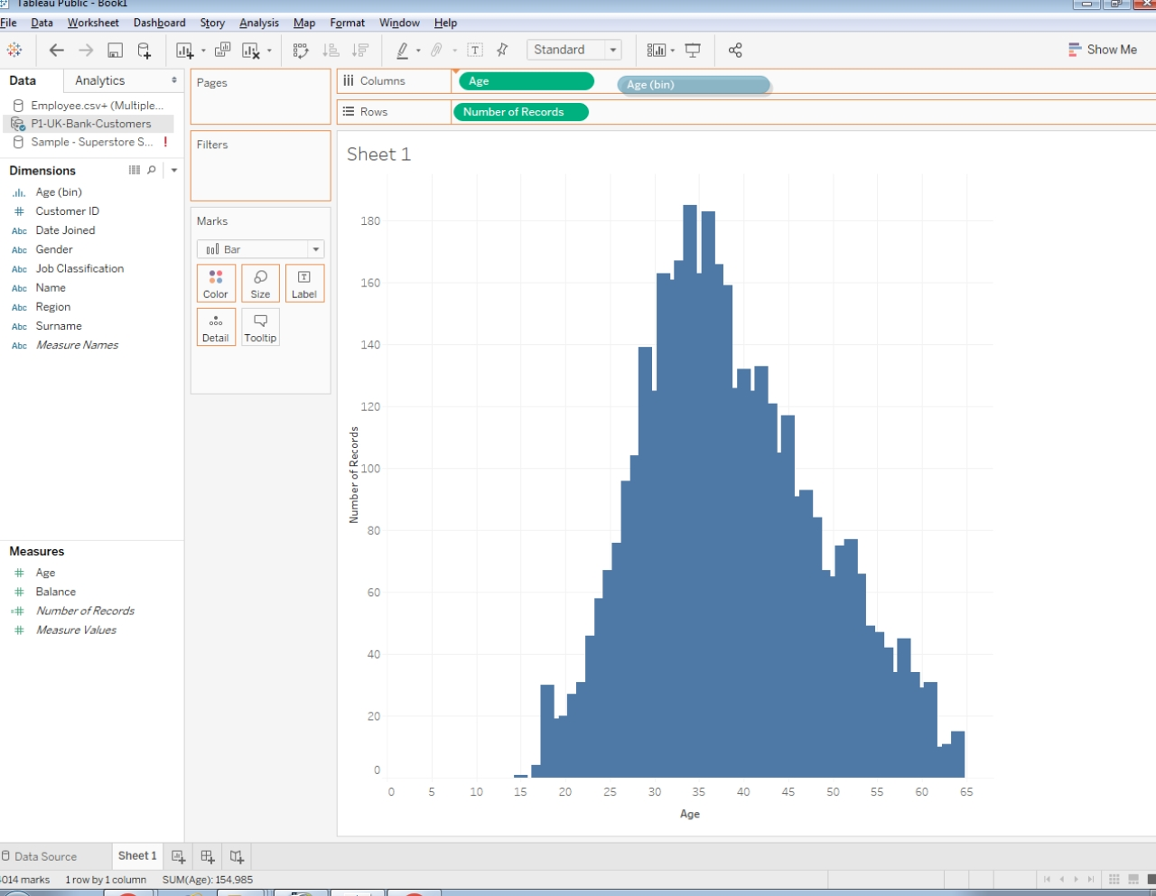

Slide 15
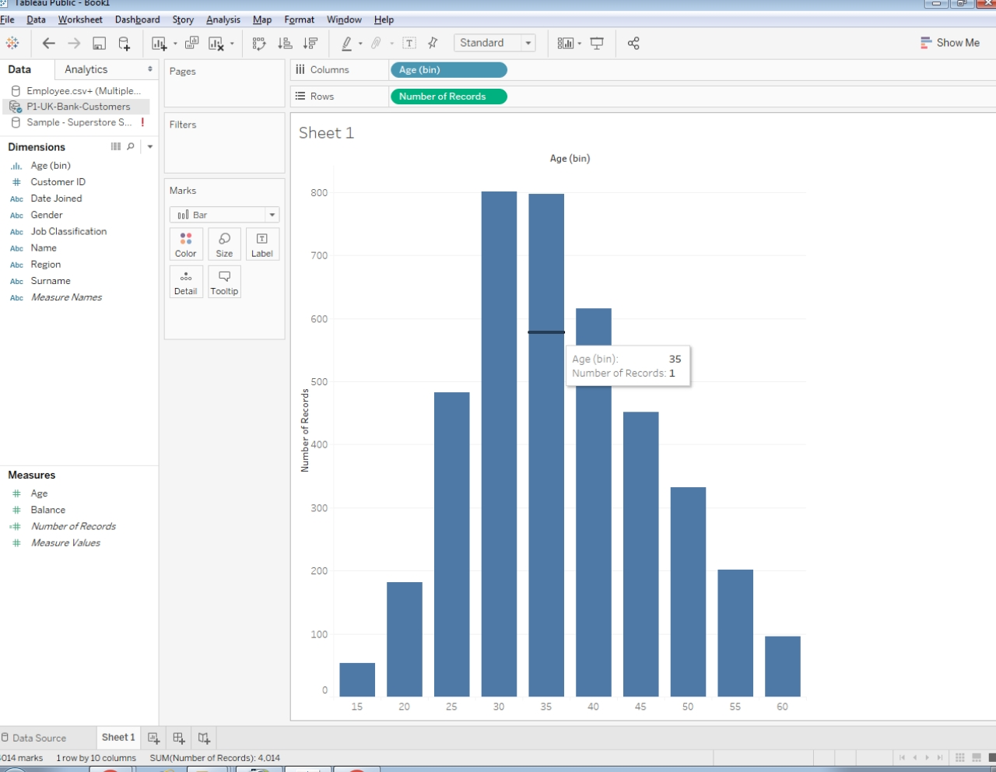

Slide 16
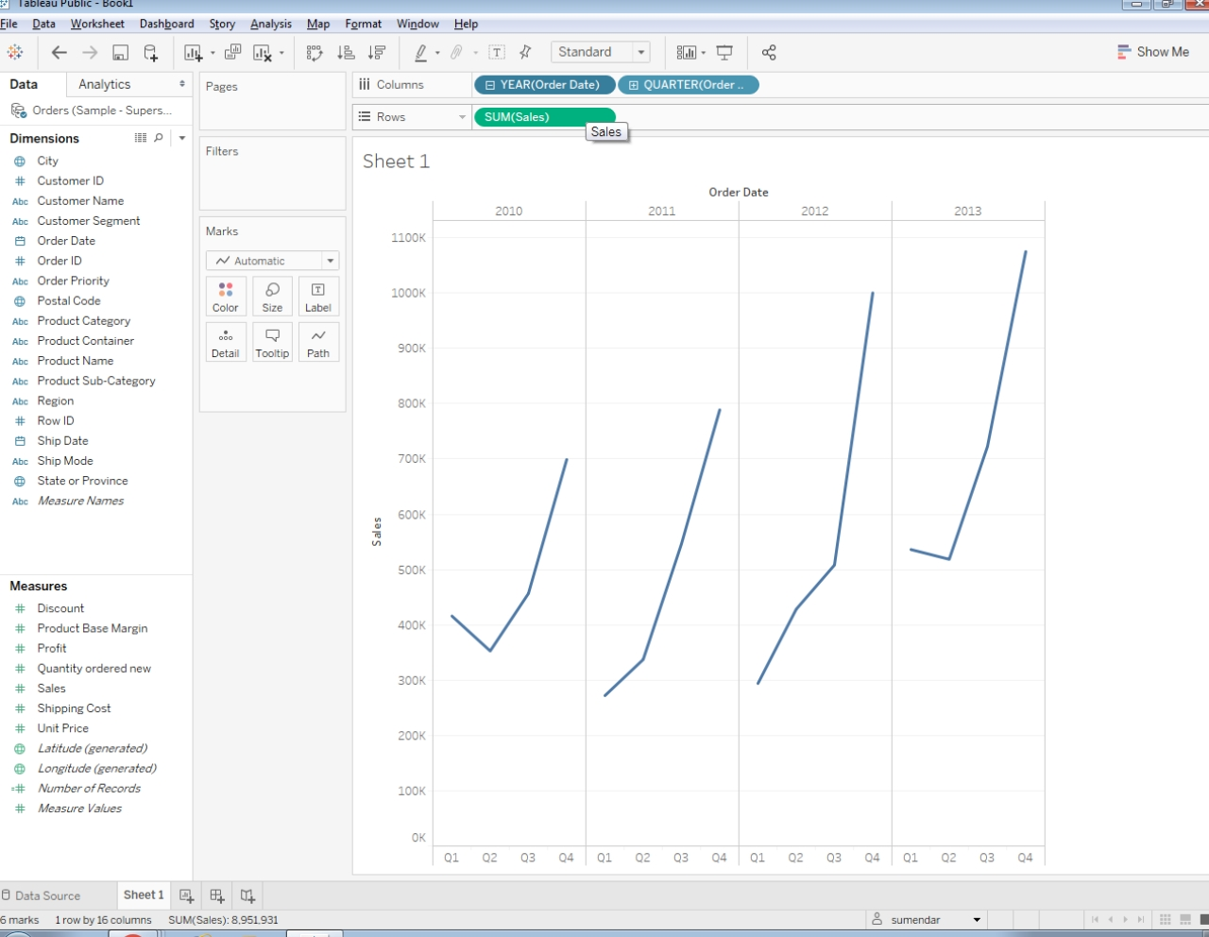
Forecasting
Notes:
Open a new workbook using a data source that contains both date values and numeric values.
Drag the Sales Measure onto the Rows shelf.
Drag the Order Date dimension onto the Columns shelf.
Drill down year to quarter

Slide 17
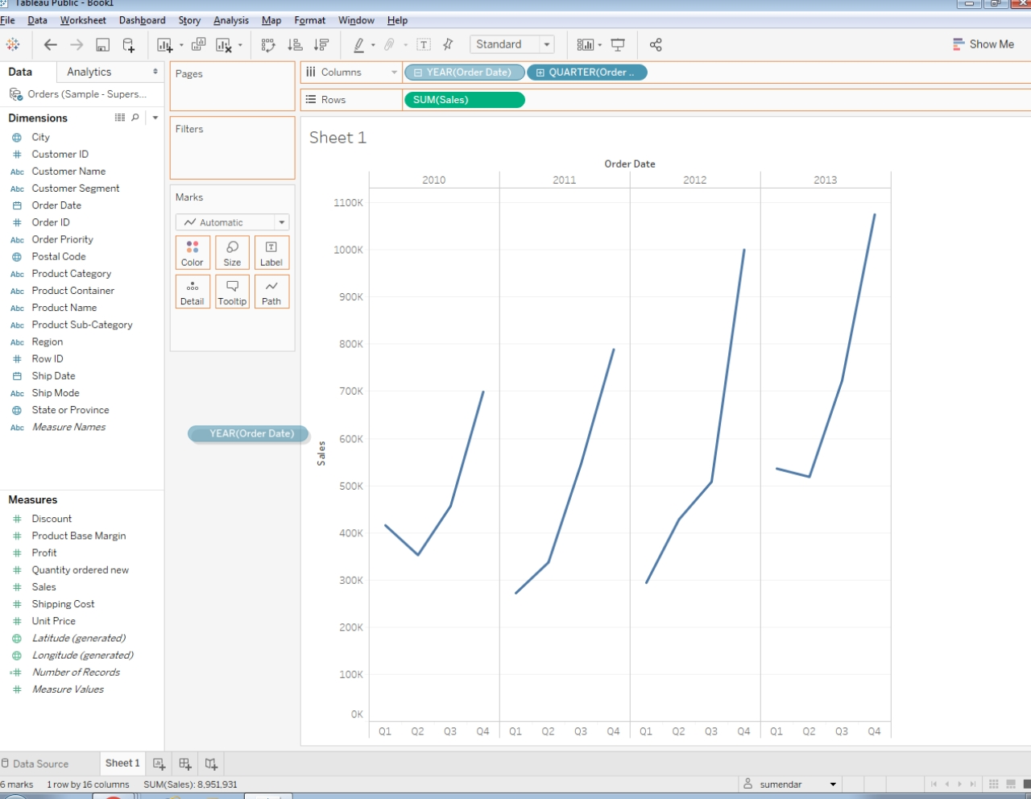
Notes:
Remove the year pill

Slide 18
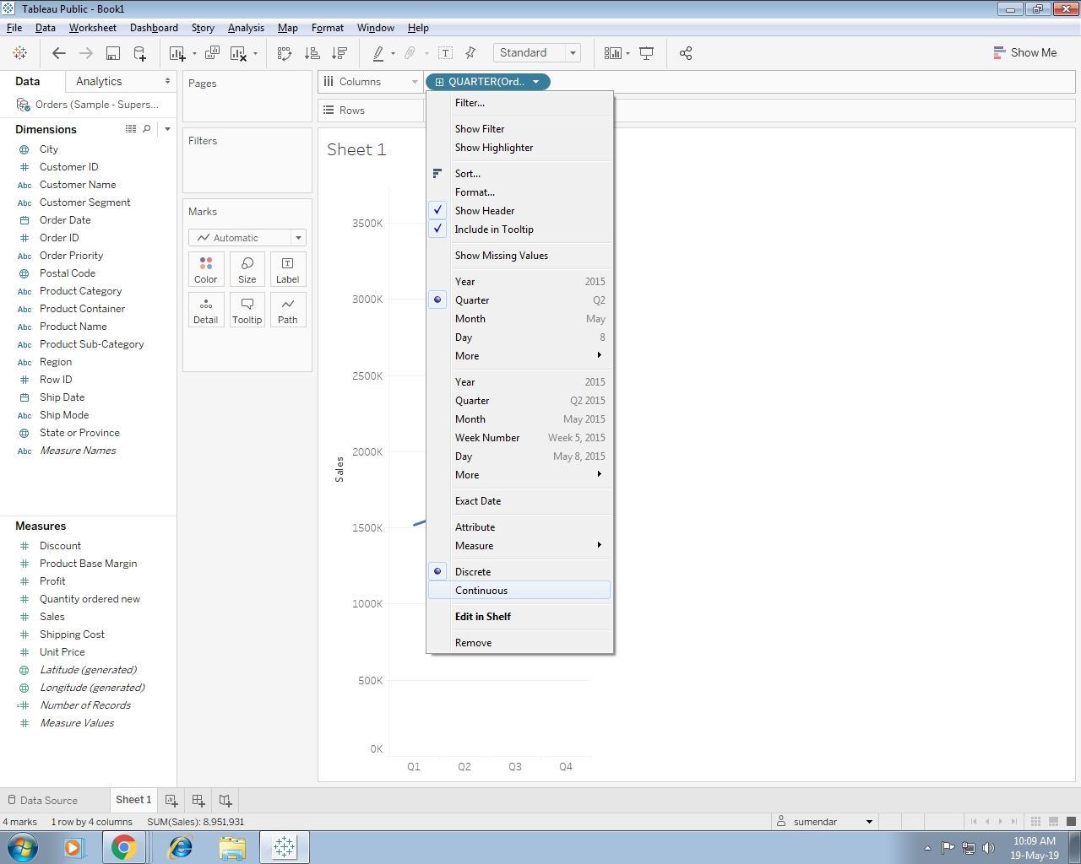
Notes:
Click the down arrow at the right side of the Order Date dimension on the Columns shelf to display the context menu and choose a continuous date option.

Slide 19
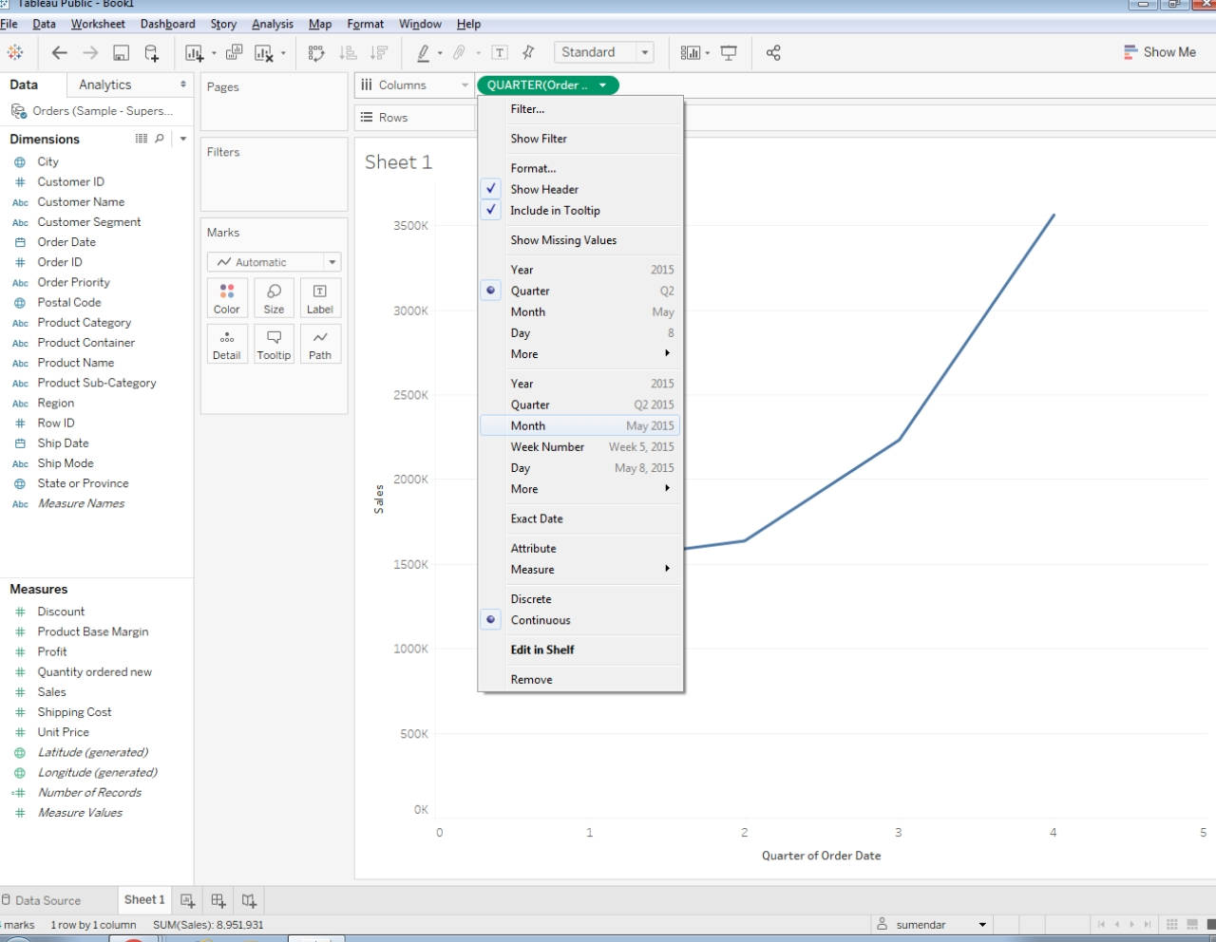
Notes:
In this case, choose the option to display the continuous month, shown as Month May 2015.

Slide 20
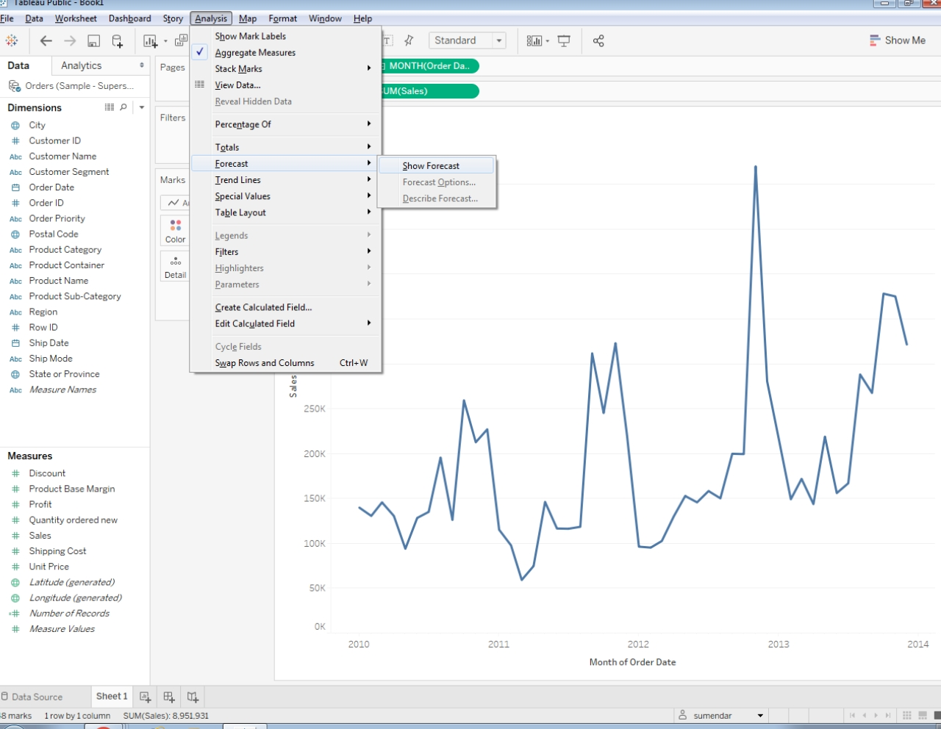
Notes:
Click the Analytics tab in the Data pane to display the analytics options.
Select The Show Forecast

Slide 21
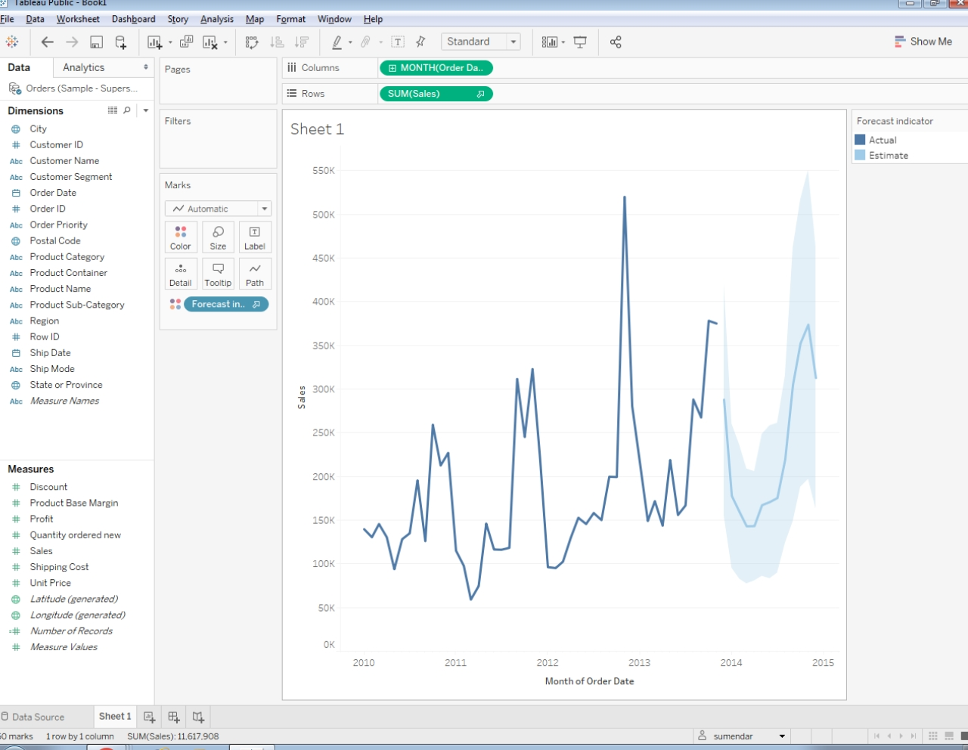
Notes:
Examine the chart to see how the sales are forecast to continue based upon the existing data.

Slide 22
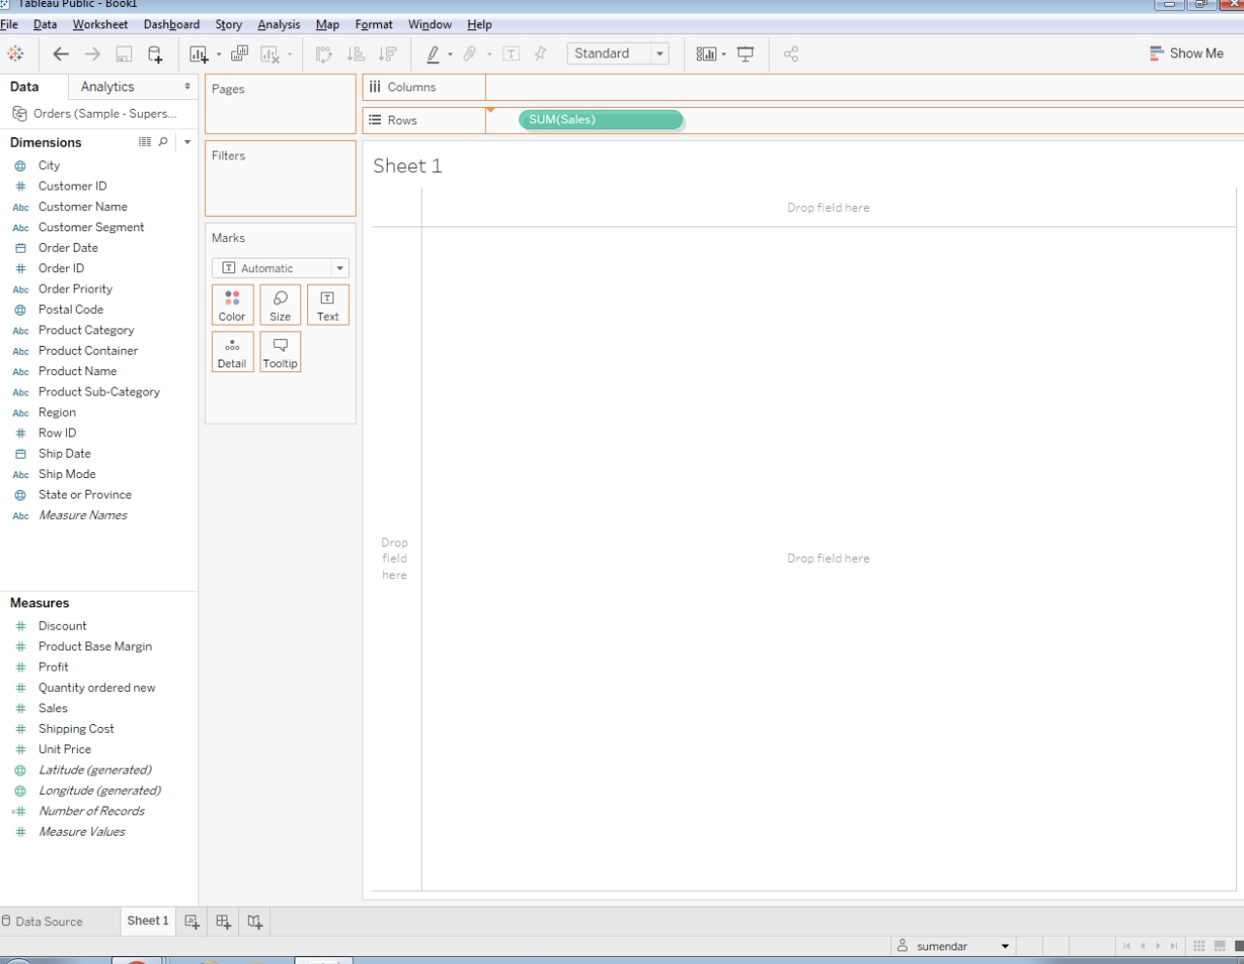
Trend Lines
Notes:
Add Sales to your Rows shelf and the Month Year option for Order Date to your Columns shelf.

Slide 23
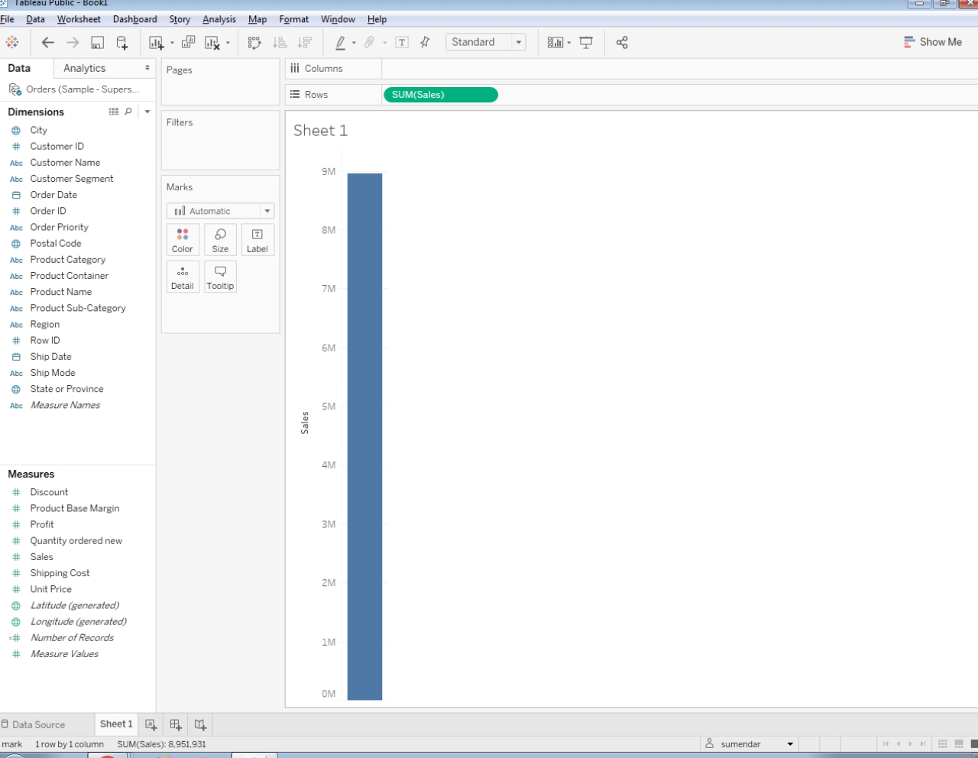

Slide 24
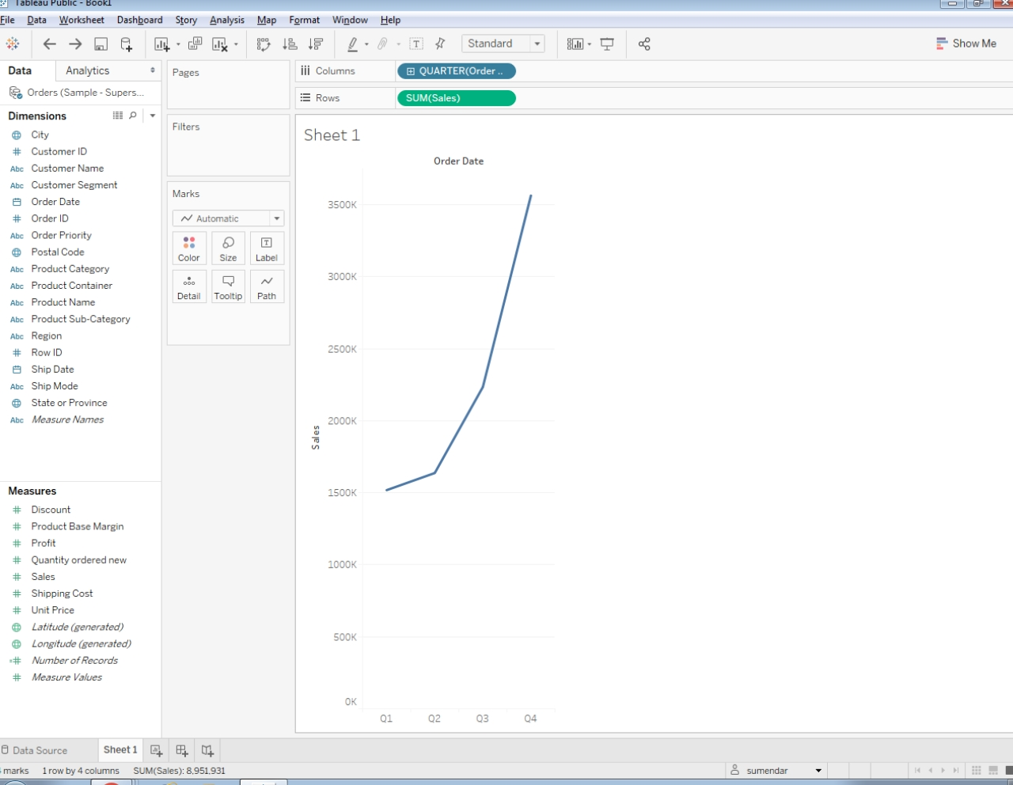

Slide 25
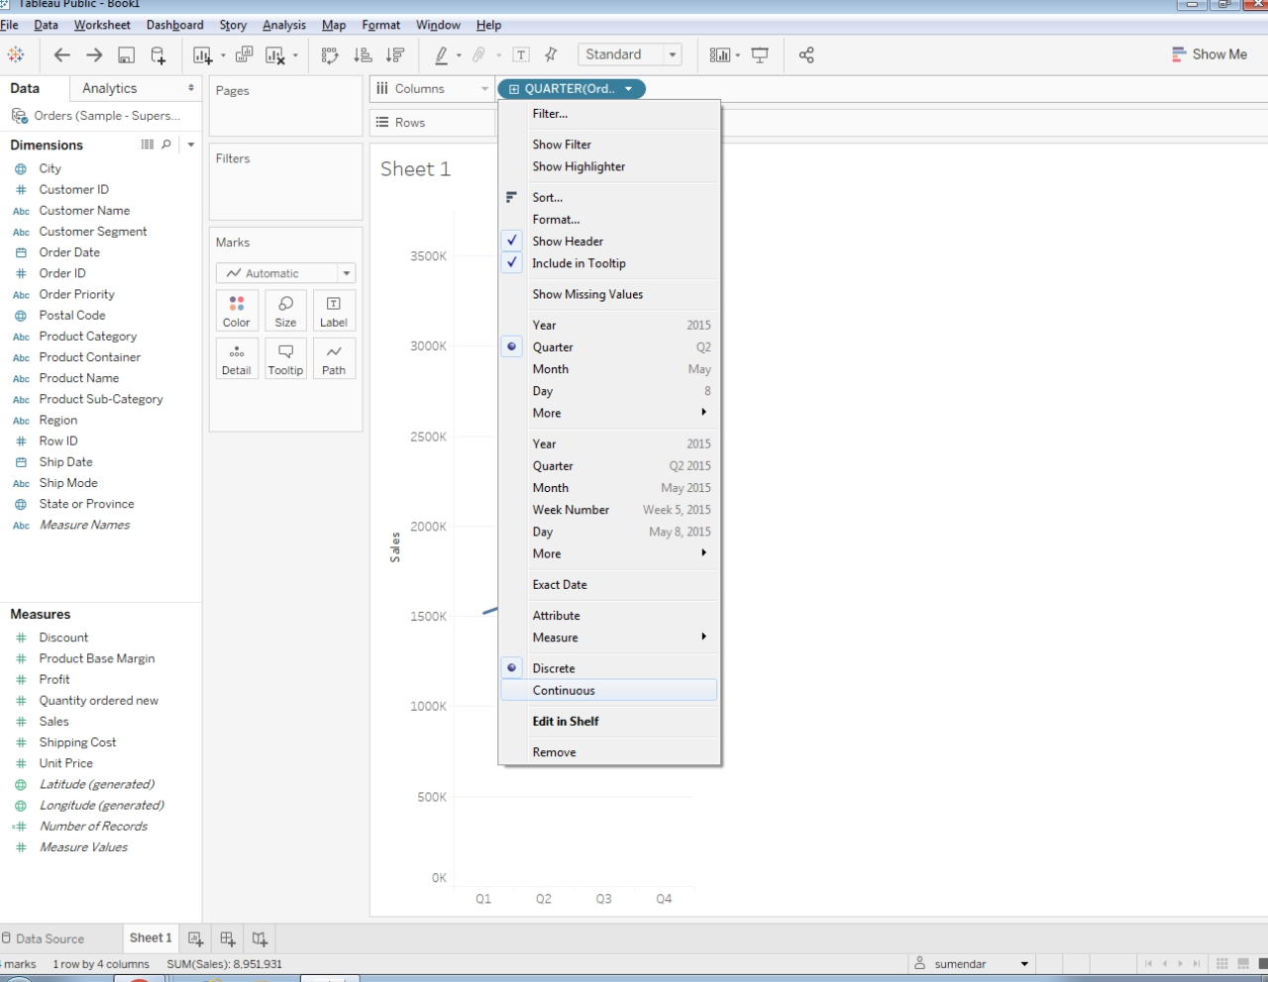

Slide 26


Slide 27
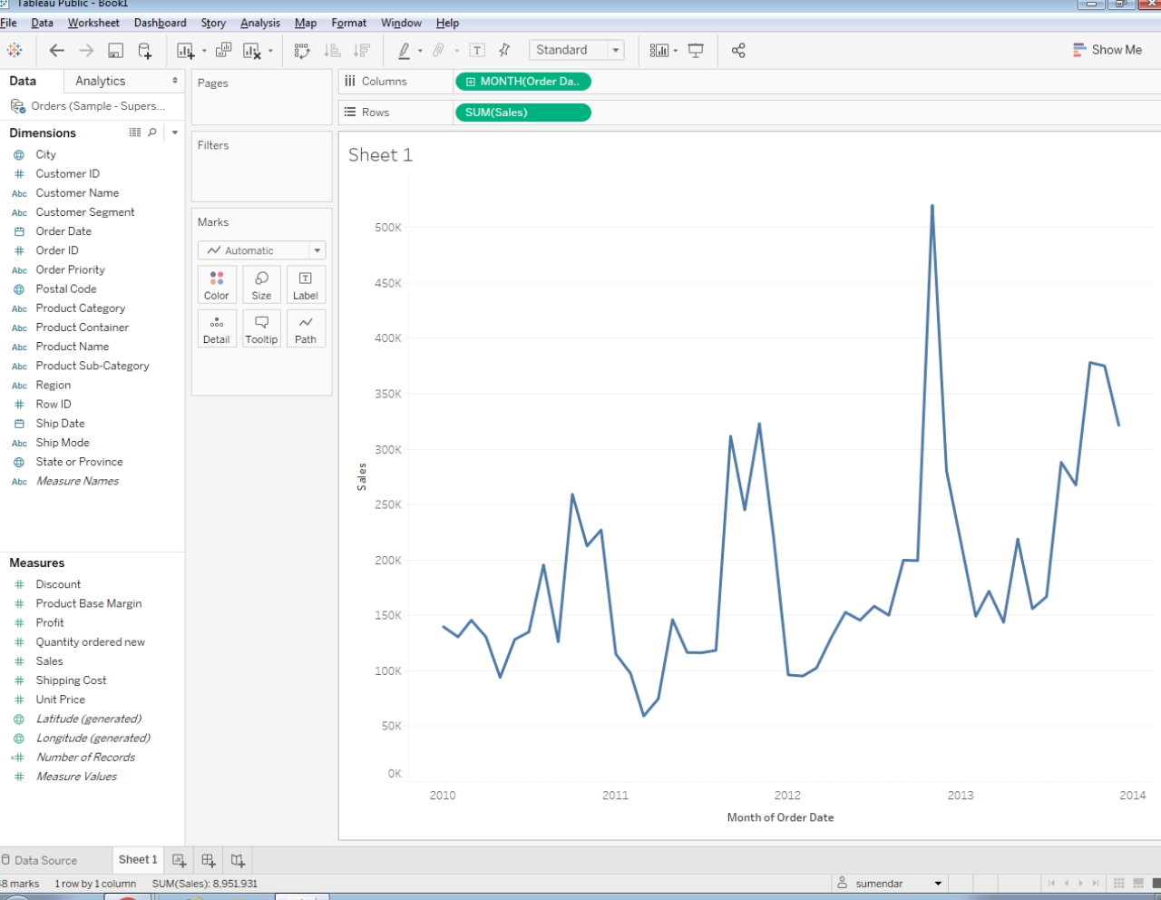

Slide 28


Slide 29
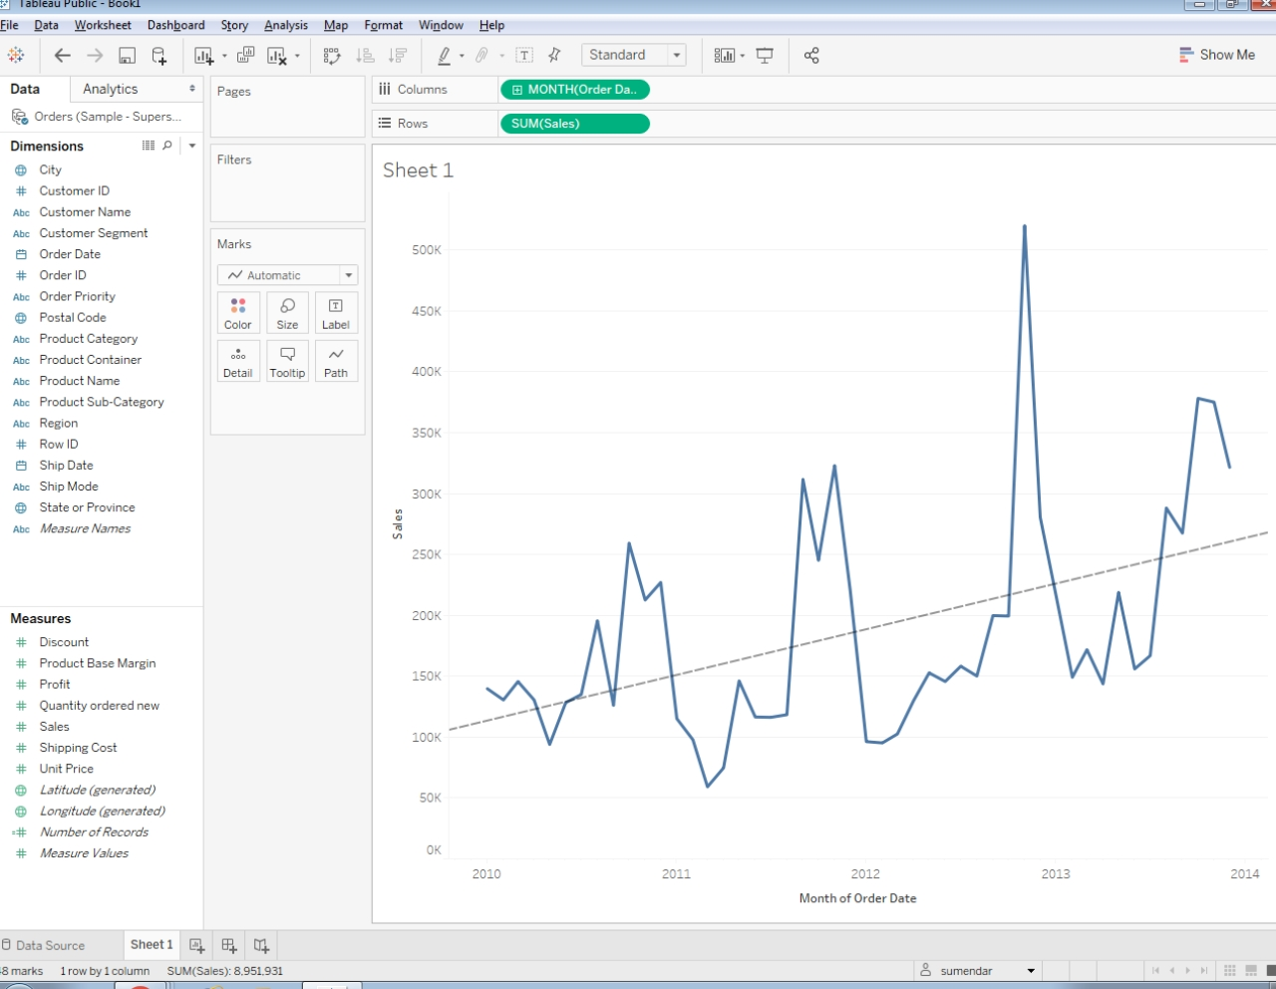

Slide 30
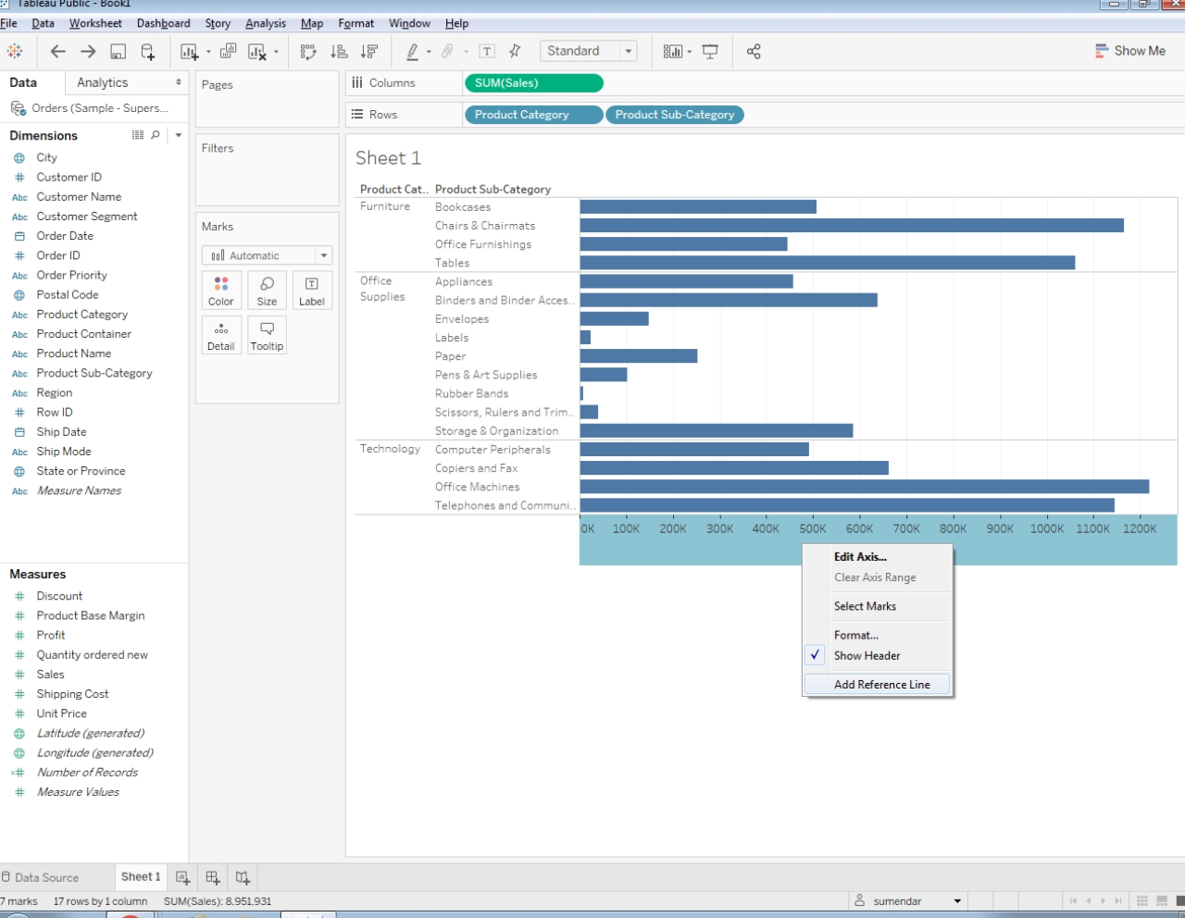
Reference Lines
Notes:
Reference lines are straight lines that originate from a constant or computed value on an axis.
To add a reference line, click on the Analytics tab and choose add reference. Add Reference Line from the pop-up menu that appears.

Slide 31
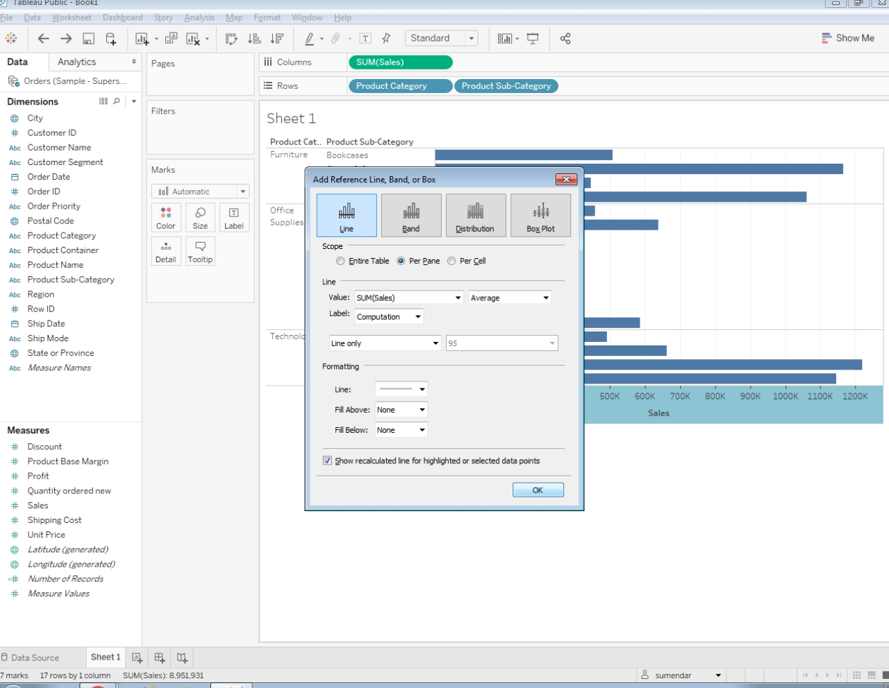
Notes:
Check out the options that appear in the dialog box for reference lines.

Slide 32
